Slide 1
Healthcare asset tracking presentation
Presented by: Daniel Faurlin and Henrique amaro
april 2020
Notes:
This BP sales training webinar will cover the global asset tracking market, key drivers and ALE solutions for the healthcare vertical.

Slide 2
Omniaccess stellar asset tracking
Global Market and ALE Solution overview

Slide 3
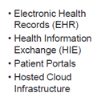
Digital health predictions
DIGITALIZATION IS IMPACTING ALL AREAS OF HEALTHCARE.
Telehealth +29%
Remote Monitoring +19%
20-30 billion IoMT devices predicted to be connected in healthcare by 2020.
Frost & Sullivan 2019
50 petabytes (estimated) of data were generated, on average, by every hospital in 2018; less than 3% were put to use.
EY 2019
Digital Health +30%
mHealth +33%
Sources: 2018-2019 Frost & Sullivan, 2019 MarketWatch
Notes:
According to consulting firm Frost & Sullivan and Marketwatch, the five most disruptive digital health predictions are:
Telehealth http://www.frost.com/sublib/display-report.do?id=K122-01-00-00-00
Remote monitoring https://store.frost.com/growth-opportunities-in-the-us-remote-patient-monitoring-market-forecast-to-2023.html
Digital Health https://ww2.frost.com/news/press-releases/frost-sullivan-reveals-2019-top-growth-opportunities-healthcare-region-and-key-sectors/
mHealth https://www.marketwatch.com/press-release/mobile-health-mhealth-services-market-size-is-projected-to-be-around-us-10400-billion-by-2022-2018-08-13
These trends drive where ALE can play a role in the future: bringing connectivity and communication services to these innovative services
- enabling Telehealth by leveraging IA and bots on our mobile communications platforms like Rainbow
- supporting Digital Health with high performing, reliable, premise and/or cloud managed infrastructure
- simplifying Remote Monitoring via a variety of remote access LAN and wireless LAN technologies
- facilitating mHealth via remote access platforms and mobile apps

Slide 4
Asset tracking market In numbers…
The market
Current issues in healthcare
The global market for asset tracking
A nurse spends more than 1 hour per day looking for someone or something**
There are approximately
15–17 devices per bed****,
and about one quarter of those bedside devices are networked
$4.5 billion*
by 2022
Many hospitals report utilization rates less of than 50% for equipment***
52%*
of the total asset tracking market will use a BLE infrastructure by 2022
Misplaced medical devices cost hospitals millions of dollars every year.
*ABI Research, 2017
**ROI of Locatible RTLS for Healthcare whitepaper, April 2015
***GE Healthcare study, 2016
****Cybersecurity: It’s Clinical, Too, Trustee magazine, 2017
Notes:
ABI Research predicted that the global market for asset tracking with reach $4.5B by 2022
According to hospital study by Locatible, a nurse spends on average 72 minutes per shift only searching for equipment
A GE study found that many hospitals are reporting equipment utilization rates of less than 50%. That’s well below what’s considered the industry-acceptable use rate of 70% to 80%.
Trustee magazine reported that there are approximately 15–17 devices per bed and about one quarter of those bedside devices are networked
So how can hospitals, clinics and assisted living facilities reduce the time it takes to find someone or something and utilize their medical devices to maximize on their investments?

Slide 5
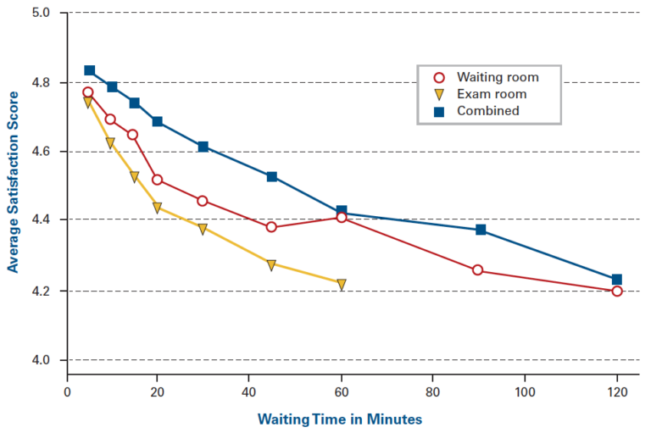
Does waiting matter to a patient?
Strong correlation between patient satisfaction and waiting times.
Longer wait times reduce patients’ perceptions of a physician’s capabilities
and
decrease patients’ confidence in the care provided
Source: Bleustein C, Rothschild DB, Valen A, Valatis E, Schweitzer L, Jones R. Wait times, patient satisfaction scores, and the perception of care. Am J Manag Care 2014 May; 20(5):393-400
Notes:
This chart shows the relationships between Waiting Times and Average Satisfaction Scores Across 44 Ambulatory Surgery Centers. There is a strong correlation between patient satisfaction and waiting time. The amount of time spent waiting in the ambulatory setting is inversely related to overall patient satisfaction. In addition, longer wait times reduce patients’ perceptions of a physician’s capabilities and decrease patients’ confidence in the care provided.

Slide 6
Omniaccess stellar asset tracking
Architecture and components

Slide 7
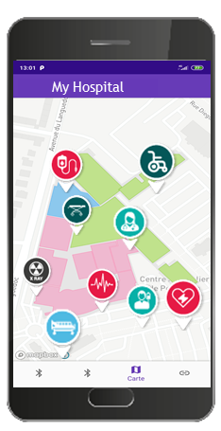
omniaccess stellar asset tracking solution
Asset Tracking
Tracking objects and people in real-time for security, compliance and time savings.
Benefits
Quickly locate assets and help optimize staff efficiency and improve the user experience
Improve operational workflows which enables clinicians to spend more time with patients
Locate assets in real-time and prevent lost/stolen equipment which saves time & costs
Accelerate return on investment and facilitate equipment maintenance
Increase people and asset security and intelligence in organizations
Notes:
The ALE OmniAccess Stellar Asset Tracking solution enables hospitals, clinics and assisted living facilities, to track objects and people in real-time for security, compliance and time savings.
Some of benefits are:
Benefits
Quickly locate assets and help optimize staff efficiency and improve the user experience
Improve operational workflows which enables clinicians to spend more time with patients
Locate assets in real-time and prevent lost/stolen equipment which saves time & costs
Accelerate return on investment and facilitate equipment maintenance
Increase people and asset security and intelligence in organizations

Slide 8
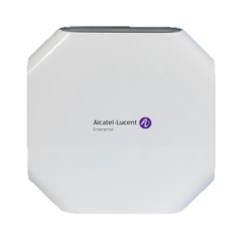
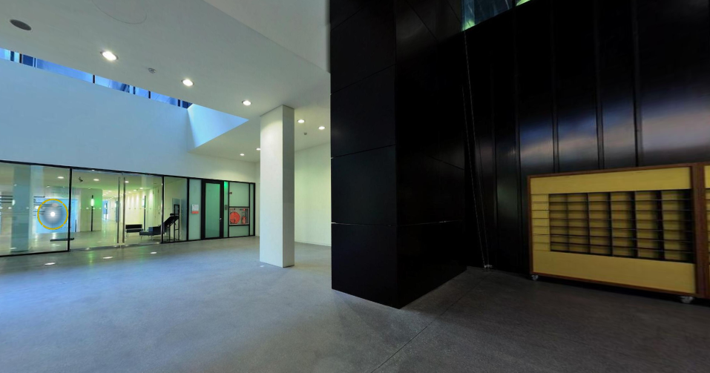
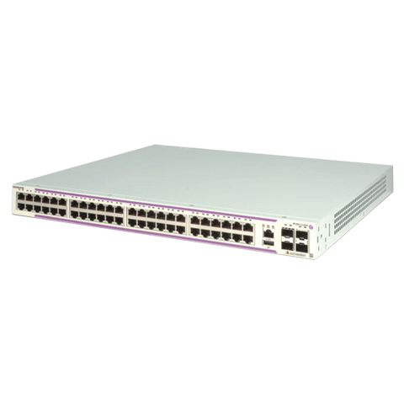
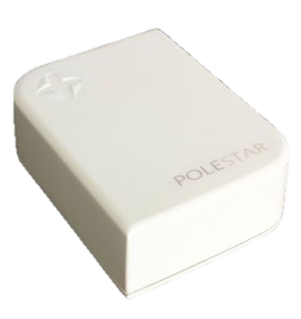
Asset tracking Architecture
AUTOCALIBRATION BEACON
AUTOCALIBRATION BEACON
OmniVista Cirrus Asset Manager with location engine Measurements every second
MOBILE TAGS
MOBILE TAGS
Notes:
The architecture for the ALE asset tracking solution starts with OmniAccess Stellar Gateways, specifically the AP1201BG. It uses BLE to receive the signals from the asset tags and provides the information to the Wi-Fi infrastructure via its Wi-Fi interface. This is not an full AP, but can be with a license upgrade fee. Stellar APs with built in BLE, or with a USB port and a BLE dongle, can provide the same function as a gateway, but gateways will be needed regardless to augment the capture of BLE asset tag signals across wide areas such as hospital floors.
Next we add autocalibration beacons (these happen to be the same beacons we use for our LBS solution) which are designed to provide a fixed position and signal strength reference for the gateways. This helps provide better accuracy for the moving asset tags.
We then add the asset tags. In 2020, we will have two types of tags, one worn as a badge for clinicians and staff which contains an alert button, and another for assets such as medical and non-medical equipment (e.g. beds, wheelchairs, etc.) This tag has a temperature sensor built-in so it can be used to track temperatures in medicine cabinets, rooms, etc. where temperature control is critical. The badge tag can be used for patients but a patient and nurse specific tag, with a programmable button for emergency or other purposes, will be available in Q1 2021.
Each tag will send its signal to any AP1201BG BLE gateway that is listening and via the gateway’s Wi-Fi interface, will send the information to the Wi-Fi infrastructure which then sends it via the network to the Stellar Asset Tracking Cloud where the location engine calculates the position of every asset tag and positions it on a floorplan map for that location.
The location information is shared across the web management app (OV Cirrus Asset Manager cloud management for the Asset tracking solution) and the smart phone app.

Slide 9
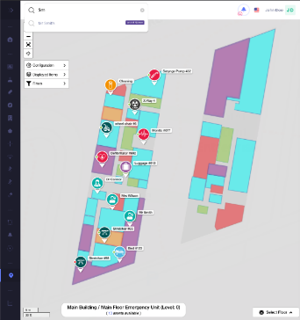
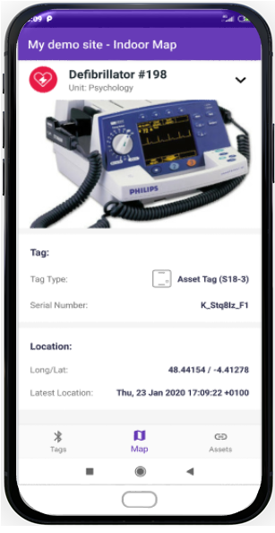
Asset tracking components (all in one offer)
1. Hardware.
OmniVista Cirrus Asset Manager (asset tag manager & location engine)
Fully integrated hardware:
BLE Gateways (AP1201BG and/or Stellar APs with built-in BLE)
Autocalibration Beacons
OmniAccess Stellar APs – Wi-Fi 5 and Wi-Fi 6* for WLAN infrastructure
BLE Asset tags
Applications:
Asset Provisioning
Asset Search
Statistics/Analytics
OmniAccess Stellar BLE Gateway AP1201BG and/or Stellar Access Points with built-in BLE*
Autocalibration BLE beacons (fixed) for location accuracy
Asset Tags
Bluetooth Low Energy (BLE)
Mobile tags for people and devices
*Wi-Fi 5 Stellar APs supported now and Wi-Fi 6 Stellar APs supported end of Q2 2020
Notes:
The ALE solution includes the hardware (BLE gateways, autocalibration beacons and asset tags), the cloud-based location engine and asset tag management tool (OmniVista Cirrus Asset Manager cloud), a web and a smartphone app. A floorplan map is also provided by ALE during the installation process.
BLE Gateways can be the new AP1201BG or any Stellar Wi-Fi 5 or Wi-Fi 6 APs with built-in BLE. Wi-Fi 6 APs will be supported by the end of Q2 2020.
Fully integrated hardware:
BLE Gateways (AP1201BG and/or Stellar APs with built-in BLE)
Autocalibration Beacons
OmniAccess Stellar APs – Wi-Fi 5 and Wi-Fi 6* for WLAN infrastructure
BLE Asset tags

Slide 10
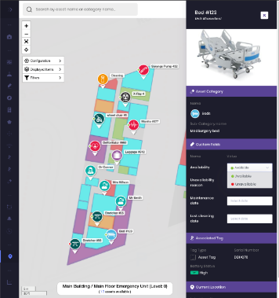
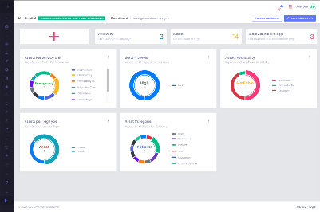
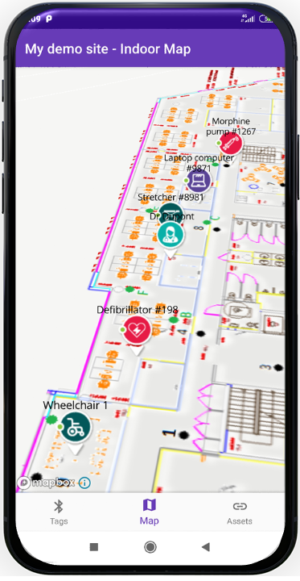
Asset tracking components (all in one offer)
2. Management tools.
OmniVista Cirrus Asset Manager web manager
APIs to 3rd party applications
Available R1.0.1 March 2020
GUI also uses these APIs so any feature will be supported
OmniVista Cirrus Asset Manager (asset tag manager & location engine)
Asset Provisioning (via web & mobile app)
Site Configuration, Subscription
This allows to associate a device, a person to a tag
Each device can be associated with an image, a category, personalized parameters (relevance)
Reassigning tags to new equipment / people
Geonotifications
Statistics & Analytics
Asset Search (via web & mobile app)
OmniAccess Stellar Asset Tracking mobile app
Quickly search for equipment, a person or a category of equipment / person
Simplified search for non-technical staff and advanced search with filters
Get inventory lists with service dates
Real-time or historical location data on equipment / people
Data related to the use of Geo Notification in a given area
Note: OV2500 or OV Cirrus are not required if using Stellar Wi-Fi in express mode
Notes:
Management of the OmniAccess Stellar Asset Tracking solution is done via the OmniVista Cirrus Asset Manager which provides the asset tag management and location engine. OV Cirrus Asset Manager is not the same as OV Cirrus NMS and is a cloud hosted in Germany. Management tools are provided to facilitate asset provisioning which can be done by web or mobile app. Note that OV2500 or OV Cirrus are not required if using Stellar Wi-Fi in express mode.
Asset Provisioning includes:
Site Configuration, Subscription
This allows to associate a device, a person to a tag
Each device can be associated with an image, a category, personalized parameters (relevance)
Reassigning tags to new equipment / people
Geonotifications (get a notification that an asset is being removed from the building e.g. wheelchairs, infusion pumps, etc. or a notification about any asset entering an existing location zone)
The cloud-based management tools also provide real-time floor plan map views of all assets and people that are wearing tags, such as clinicians, patients, security staff, as well as, daytime contractors or any one or thing you wish to keep track of.
Asset Search includes:
Quickly search for equipment, a person or a category of equipment / person
Simplified search for non-technical staff and advanced search with filters
Get inventory lists with service dates
Statistics & Analytics includes:
Real-time or historical location data on equipment / people
Data related to the use of Geo Notification in a given area
APIs for 3rd party applications:
Available R1.0.1 March 2020
GUI also uses these APIs so any feature will be supported

Slide 11
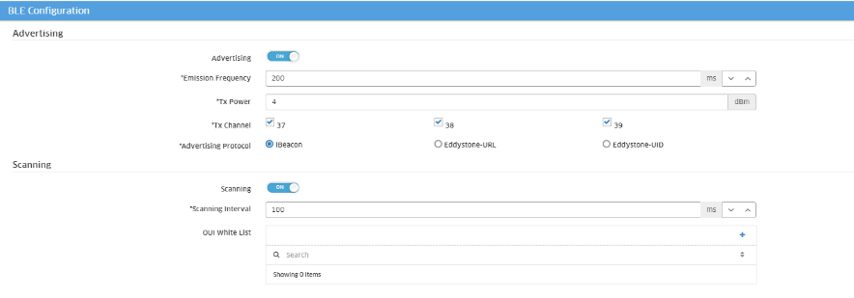
NEW BLE GATEWAY – Omniaccess stellar AP1201BG
Powerful with integrated BLE
AP1201BG BLE Gateway is based on AP1201 hardware (ships with default configuration)
No configuration required if connected to LAN
Integrated BLE can serve as both a BLE Gateway and Beacon simultaneously
Only Wi-Fi Client functionality (no AP capability without upgrade)
Cloud connectivity over Wi-Fi or Ethernet
Power over Ethernet or AC power
Eliminates the need for a separate BLE infrastructure for LBS and asset tracking
Lower list price than AP1201 and no OmniVista NMS licenses required
OmniAccess Stellar AP1201BG $295 list price
Notes:
The OmniAccess Stellar AP1201BG is a new BLE gateway. Some of it’s powerful features and capabilities include:
AP1201BG BLE Gateway is based on AP1201 hardware (ships with default configuration)
No configuration required if connected to LAN
Integrated BLE can serve as both a BLE Gateway and Beacon simultaneously
Only Wi-Fi Client functionality (no AP capability without upgrade)
Cloud connectivity over Wi-Fi or Ethernet
Power over Ethernet or AC power
Eliminates the need for a separate BLE infrastructure for LBS and asset tracking
Lower list price than AP1201 and no OmniVista NMS licenses required

Slide 12
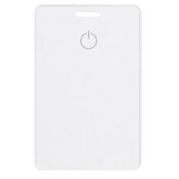
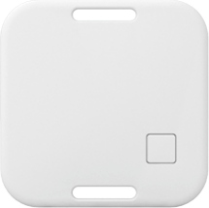
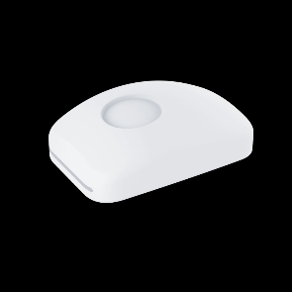
Asset TAG models
Different types of tags with different mounting options to take into account several deployment scenarios
Clinician/staff tags with alert button –
Cards that can be attached to a badge
Asset tags with temperature sensor
Attach to a variety of medical and non-medical equipment
Nurse/patient tags with programmable alert button
Ability to integrate a bracelet
Available H2 2020
CT18-3-40 Card shaped asset tag 40 pack $2600 list price ($65 each)
S18-3-40 Square shaped asset tag 40 pack $2400 list price ($60 each)
Notes:
Different types of tags with different mounting options to take into account several deployment scenarios.
Clinician/staff tags with alert button. Cards that can be attached to a badge and can be used for patients until the nurse/patient specific tag is available.
Asset tags with temperature sensor. Attach to a variety of medical and non-medical equipment
Nurse/patient tags with programmable alert button. Ability to integrate a bracelet. This one will be available in H2 2020

Slide 13
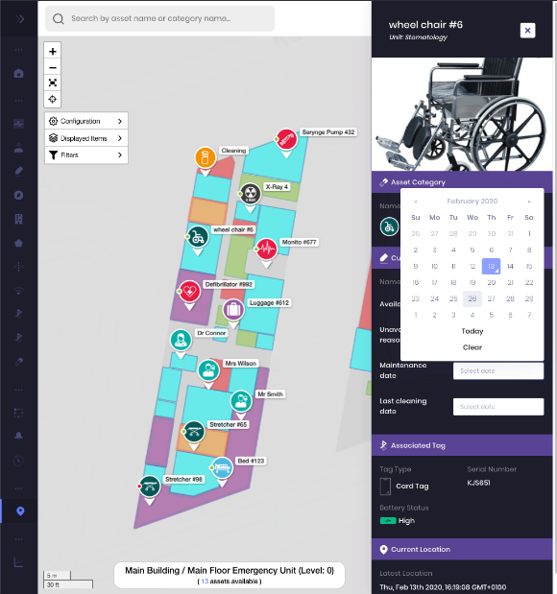
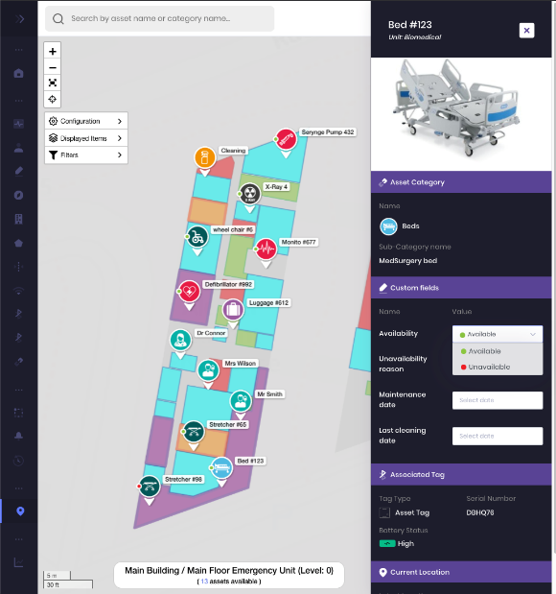
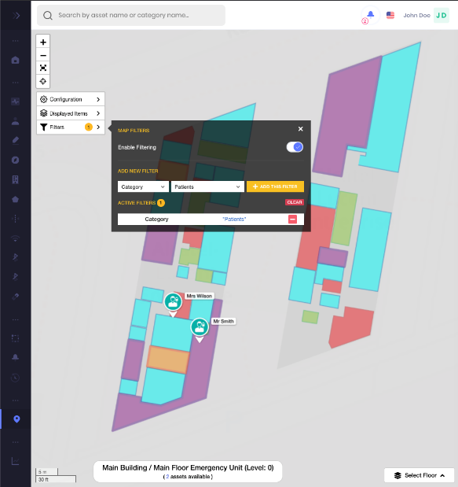
Asset tracking Web management tool
Locate medical/non-medical devices, equipment and people with filters.
Available R.1.0.1 March 2020
Notes:
Here are a few of the web management screens that will be available in March 2020 with R.1.0.1
You can see the position of assets, look up the information on a specific asset, set up notifications e.g. for maintenance schedules.

Slide 14
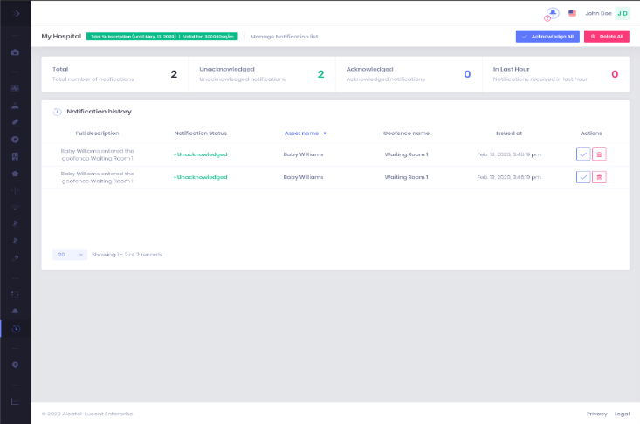
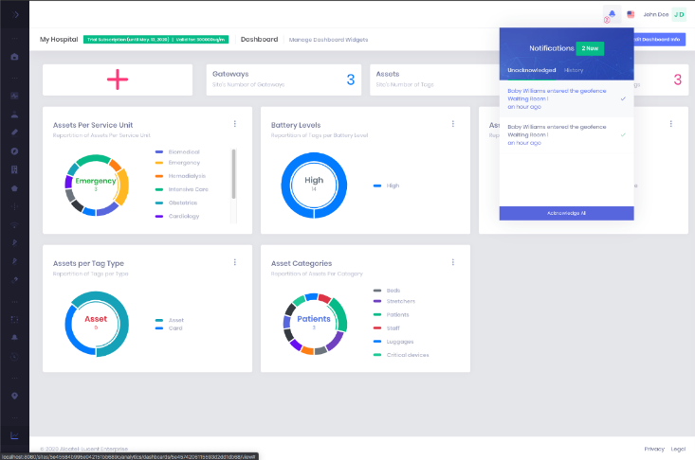
Asset tracking analytics
Asset tag analytics and notifications.
Available R.1.0.2 May 2020
Notes:
The value of location services such as asset tracking is the ability to capture asset tag analytics. This information allows a healthcare facility to keep track of all of their assets, both the ones in use and the ones available (that have been logged). You’ll also get historical data on the flow of patients, clinicians and equipment so a hospital can optimize workflows accordingly to make work and patient care more efficient and effective.
The ability to set up and see a list of notifications allows you to be proactive about maintenance, keeping track of where equipment is moved to, know that patients and staff are safe, by defining boundaries where people or assets shouldn’t cross.

Slide 15
Healthcare based icons
Choose the equipment tor people asset icon you need from a large library.
Icons show in-use or available status, waypoints
Medical equipment icons include: heart rate monitors, infusion pumps, syringes, etc.
Non-medical equipment icons include: wheelchairs, beds, mattresses, carts, etc.
People icons include: patients, staff, security
Available R.1.0.1 March 2020
Notes:
There is large library of icons that can be used for the various assets to be viewed and tracked on a floorplan map. Each icon is available with or without a waypoint indicator and is also color coded so a hospital can set a color to indicate that a wheelchair (or other piece of equipment or staff) is not currently available or if it/he/she is.
People icons include: patients, staff, security
Medical equipment icons include: heart rate monitors, infusion pumps, syringes, etc.
Non-medical equipment icons include: wheelchairs, beds, mattresses, carts, etc.

Slide 16
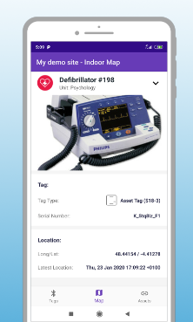
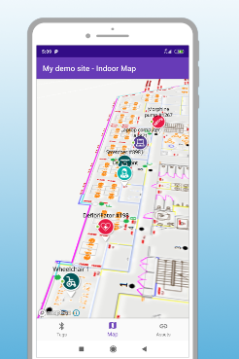
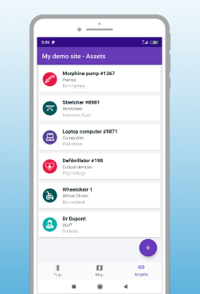
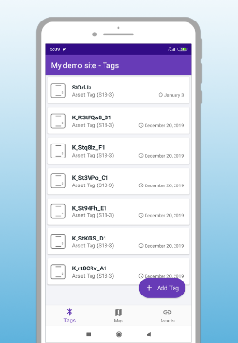
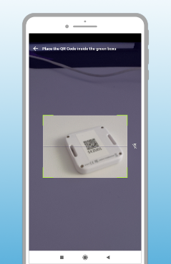
Asset tracking mobile app
Find people and assets instantly
Locate people & assets on a floorplan
Visualize all of your assets
See all your tags in one place
Quickly scan and log a tag by QR code
Available R.1.0.1 March 2020
Notes:
The Stelllar ALE asset tracking app is Android based and allows you to perform a number of AT related functions, which include”
Find people and assets instantly
Locate people & assets on a floorplan
Visualize all of your assets
See all your tags in one place
Quickly scan and log a tag by QR code

Slide 17
Find people or assets instantly
With web or mobile app.
Alcatel-Lucent OmniAccess® Stellar Asset Tracking saves staff time with simple-to-use features, such as:
Simplified search interface for non-technical staff
Advanced search with filtering feature and future advanced search combining multiple choices (asset + service + availability)
Role based access for locating an asset
Search based on individual asset/person name or on a category of asset/person
Web based asset search with optimized responsive design to ensure various devices can leverage it
Mobile App based search
Customizable asset category parameters for various healthcare use cases
Available R.1.0.1 March 2020
Notes:
Find people or assets instantly
Alcatel-Lucent OmniAccess® Stellar Asset Tracking saves staff time with simple-to-use features, such as:
Simplified search interface for non-technical staff
Advanced search with filtering feature and future advanced search combining multiple choices (asset + service + availability)
Role based access for locating an asset
Search based on individual asset/person name or on a category of asset/person
Web based asset search with optimized responsive design to ensure various devices can leverage it
Mobile App based search
Customizable asset category parameters for various healthcare use cases
Timeline – March 2020

Slide 18
Locate patients, clinicians and assets on a floorplan
Geolocation icons on a floorplan map.
Tracking objects and people in real-time using geolocation, makes patient care more efficient and can help improve processes and workflows in hospitals, clinics and assisted living facilities
Some of the benefits include:
Improved equipment utilization and reduced overhead costs
Better tracking of assets in and around a healthcare facility to avoid theft
Improved caregiver satisfaction by reducing the time needed to locate resources
Improved patient experience as caregivers can spend more time with them
Available R.1.0.1 March 2020
Notes:
Locate patients, clinicians and assets on a floorplan
Tracking objects and people in real-time, makes patient care more efficient and can help improve processes and workflows in hospitals, clinics and assisted living facilities
Some of the benefits include:
Improved equipment utilization and reduced overhead costs
Better tracking of assets in and around a healthcare facility to avoid theft
Improved caregiver satisfaction by reducing the time needed to locate resources
Improved patient experience as caregivers can spend more time with them
Timeline – March 2020

Slide 19
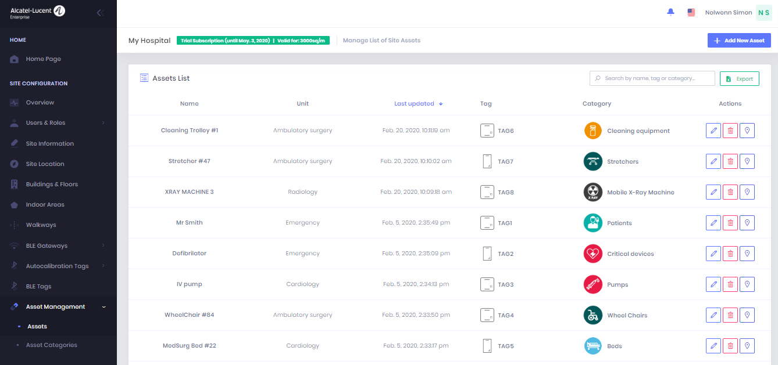
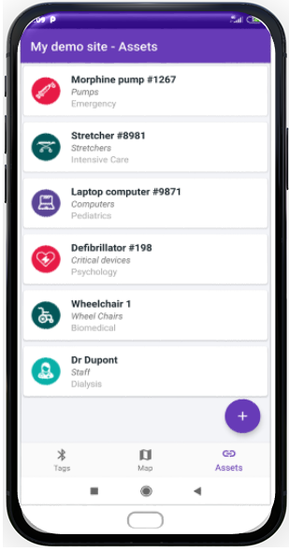
Visualize your assets
Which assets are available or being used.
See which assets are available then find them on a floorplan map
You’ll know which equipment is nearest to you or to your patients
With equipment and role specific icons, it makes it easier to locate the person or asset you need by icon graphic and color
Custom fields can be used to set up personalized parameters directly through the app
Available R.1.0.1 March 2020
Notes:
Visualize your assets
See which assets are available then find them on a floor plan map. You’ll know which equipment is nearest to you or to your patients. With equipment and role specific icons, it makes it easier to locate the person or asset you need by icon graphic and color. And custom fields can be used to set up personalized parameters directly through the app.
Timeline – March 2020

Slide 20
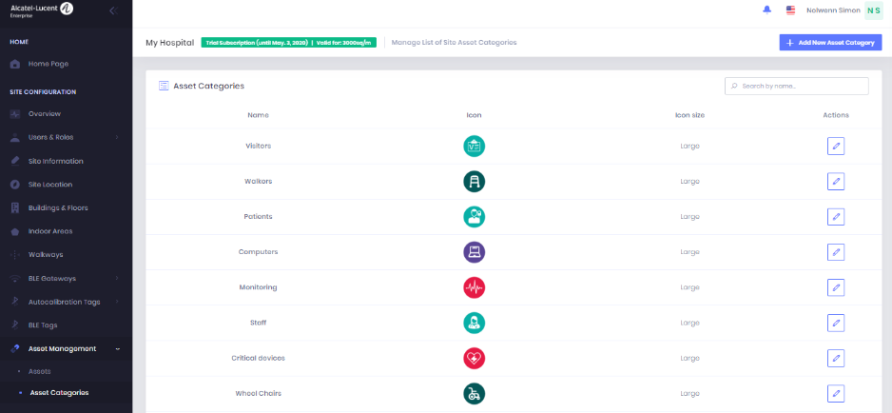
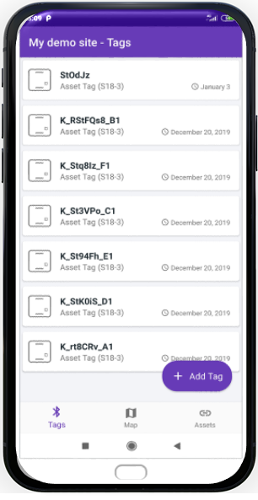
All your tags in one place
Inventory lists and service schedules.
Provide a full inventory list of asset tags to ensure all or your equipment is accounted for
See which devices are due for service
Simplify managing and maintaining the asset tracking network by IT
Provide real-time audit data for hospital operations
Get notifications of planned service of assets on the app (Available R.1.0.2 May 2020)
Available R.1.0.1 March 2020
Notes:
All your tags in one place
You can provide a full inventory list of asset tags to ensure all or your equipment is accounted for and see which devices are due for service. This simplifies managing and maintaining the asset tracking network by IT, while providing real-time audit data for hospital operations. And in May 2020, you’ll be able to receive notifications for planned service of assets on the app.
Timeline – March 2020

Slide 21
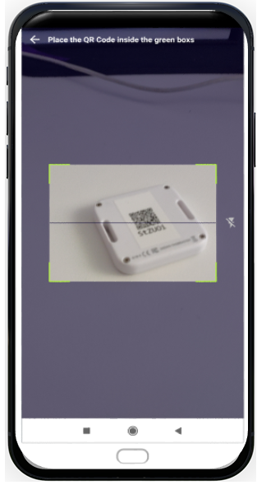
Associate a tag to an asset easily using a QR code
Scan and log.
Assigning an asset tag to an asset is as simple as scanning the tag’s QR code into our smartphone app
Greatly simplifies the addition of tags to a hospital network
Allows various asset names and icons to be used to differentiate tags as necessary
The department name and the asset category, can also be customized, based on the needs of a specific environment
You can add a future service date for your equipment to be checked, cleaned, and/or serviced
Asset tracking software will send a preemptive notification to ensure an asset doesn’t miss its service schedule
Available R.1.0.1 March 2020
Notes:
Associate a tag to an asset easily using a QR code
Assigning an asset tag to an asset is as simple as scanning the tag’s QR code into our smartphone app. This greatly simplifies the addition of tags to a hospital network and allows various asset names and icons to be used to differentiate tags as necessary.
The department name for which a tag is associated to, can also be programmed, including a future service date, so when it’s time get your equipment checked, cleaned, and/or serviced, the asset tracking software will send you a preemptive notification to ensure an asset doesn’t miss its service schedule.
Timeline – March 2020

Slide 22
Asset category and customizable fields
Keep detailed information on each asset.
Set up an asset category for each asset
By name and sub-category name
Use customized fields to identify:
Availability (whether an asset is available)
Unavailability reason (in use, maintenance, cleaning)
Maintenance date (when it is due for maintenance)
Last service/cleaning date (to ensure you follow compliance requirements)
Any other type of customized field based on a healthcare provider’s needs
Available R.1.0.1 March 2020
Notes:
Keep detailed information on each asset
Set up an asset category for each asset
By name and sub-category name
Use customized fields to identify:
Availability (whether the asset is available or not)
Unavailability reason (in use, maintenance, cleaning)
Maintenance date (when it is due for maintenance)
Last service/cleaning date (to ensure you follow compliance requirements)
Any other type of customized field based on a healthcare provider’s needs
Timeline – March 2020

Slide 23
Competition and ale differentiation

Slide 24
Stanley healthcare – pros & cons
Notes:
Note that Stanley healthcare uses Wi-Fi technology and for in-room accuracy, use ultra sound technology from Sonitor at about $2500 per room.

Slide 25
Aruba HPE – pros & cons
Notes:
Aruba has only one BLE asset tag they use with different mounting options
Aruba BLE asset tag can only work with the Aruba APs that have built-in BLE and these are expensive (they have no gateways)

Slide 26
Centrak – Pros & Cons
Notes:
Centrak also uses Wi-Fi technology and uses infrared technology for in-room accuracy at about $2000 per room.

Slide 27
Juniper – Mist Pros & Cons
Virtual BLE provides accuracy only in very open environment
No other solution apart form virtual Beacons.
No dedicated vertical solution
Notes:
Mist provides virtual beacon technology which is optimized for very open environments and not complex floorplans such as in hospitals
In room accuracy is unknown but expected to be poor or very expensive if augmented with more Wi-Fi infrastructure products

Slide 28
Pricing comparison over 10 Years
Assumptions
 | Stanley Healthcare | Aruba-HPE | Juniper-Mist | ALE
CAPEX | 3,706,261 | 1,362,995 | 1,618,750 | 1,337,500
OPEX | 4,402,760 | 2,829,950 | 4,150,000 | 2,687,500
Per Year Software license pricing per 1000 Sq meter covering deployment for next 10 Years | 6,160 | 6,000 | 1,500 | 6,000
Total System price for 10 Years | 8,109,021 | 4,192,945 | 5,768,750 | 4,025,000
Square meters | 250000
Software support | 18%
Per 1000 sq. meters
Number of APs | 5
Stanley - Extra APS required | 2
Number of tags per 1000 SqM. | 75
Number of Exciters* per 1000 SqM. | 5
AVG Price of Aps | 300
AVG Price of BLE GW | 200
ALE autocalibration beacons | 10
Accuracy level (room & floor) – 5m
ALE has the most competitive price overall
*Used by Stanley Healthcare to provide alerts/status in specific areas (ALE does this using virtual perimeters)
Notes:
10-year asset tracking solution prices vary but ALE has the most competitive price overall. This example is based on a 250,000 square meter coverage area and an accuracy level of up to 5 meters. You’ll note that Stanley Healthcare requires 2 additional APs and 5 exciters per 1000 square meters, in addition to the 5 APs for each vendor. ALE doesn’t require any exciters for it’s asset tracking solution as we can set up virtual perimeters to get alerts and geonotifications.

Slide 29
Asset tracking use cases

Slide 30
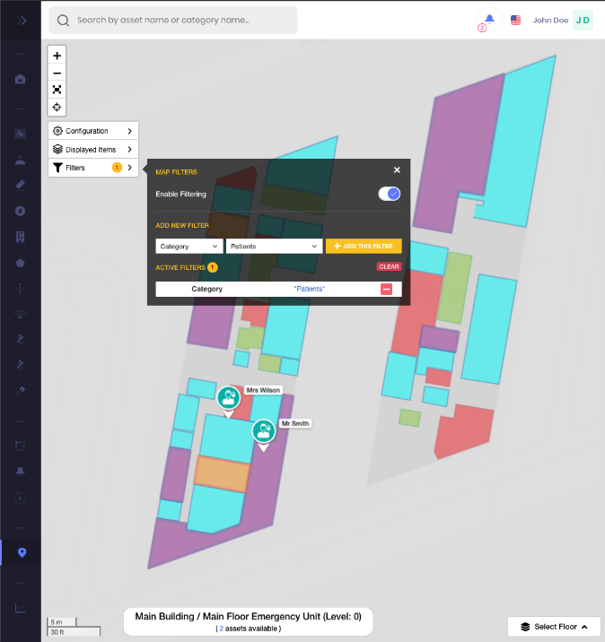
Locate assets and people in real-time
Use web management tool or mobile app.
Available R.1.0.1 March 2020
Available R.1.0.1 March 2020
Notes:
Pull up a floorplan map and search for an asset or enter the type of asset you need and the web management tool or mobile app will provide the location information in real-time. Asset locations are updated in seconds, versus minutes for others like Aruba HPE.
Timeline - March 2020

Slide 31
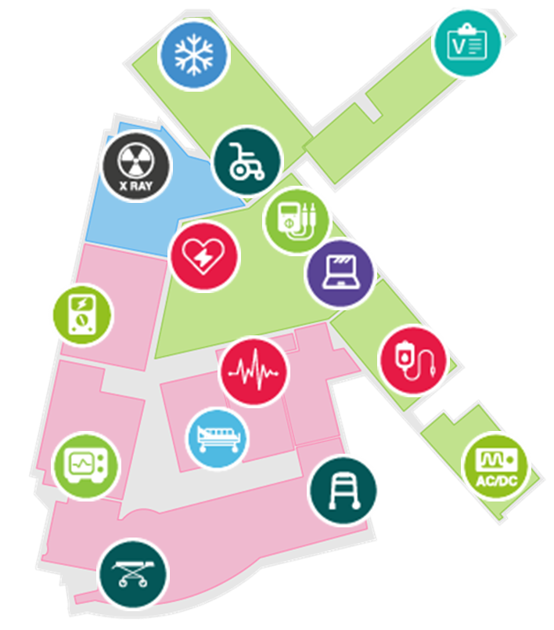
Geonotification
Asset theft protection.
Avoid lost, stolen or misplaced assets
Set up virtual zones for asset theft protection
Receive a geonotification alert (location based notification) when an asset leaves a specified area
Send the appropriate staff to collect that asset
Available R.1.0.2 May 2020
Notes:
Geonotifications can help prevent asset theft
Avoid lost, stolen or misplaced assets
Set up virtual zones for asset theft protection
Receive a geonotification alert (location based notification) when an asset leaves a specified area
Send the appropriate staff to collect that asset
Timeline - May 2020

Slide 32
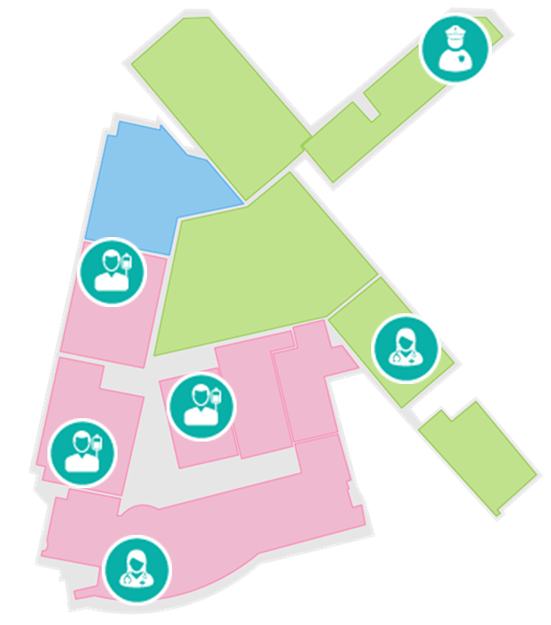
Patient tracking
Avoid exposure to infectious diseases.
Track patients for their safety and the safety of others*
Avoid the spread of infectious diseases by knowing where the affected patients are at all times*
Set up virtual zones for quarantined areas to get geonotifications should a patient wander beyond the perimeter**
Track history of patient and clinician movement to do forensics on disease spread**
*Available R.1.0.1 March 2020
**Available R.1.0.2 May 2020
Notes:
Patient tracking can help avoid exposure to infectious disease
*Track patients for their safety and the safety of others
*Avoid the spread of infectious diseases by knowing where the affected patients are at all times
**Set up virtual zones for quarantined areas to get geonotifications should a patient wander beyond the perimeter
**Track history of patient and clinician movement to do forensics on disease spread
*Timeline - March 2020
**Timeline - May 2020

Slide 33
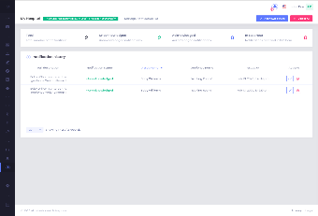
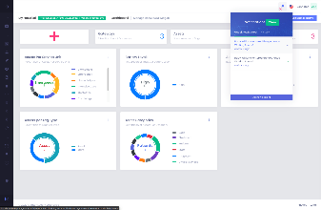
Maintenance workflow optimization
Asset management system tracks maintenance schedule of each asset
Asset management system sends notification to operations manager about upcoming maintenance and timeline
Operations manager proactively schedules maintenance
4
Maintenance person uses asset tracking app to located assets that require maintenance.
Saves time not looking for assets.
1
2
3
Available R.1.0.2 May 2020
Notes:
Maintenance workflow optimization
Each asset that the ALE Stellar asset tracking solution manages can support multiple customizable fields which allow admin to add a maintenance date to track maintenance. ALE provides the dashboard and notification alerts that are sent whenever the maintenance schedule coming due.
Asset management system tracks maintenance schedule of each asset
Asset management system sends notification to operations manager about upcoming maintenance and timeline
Operations manager proactively schedules maintenance
Maintenance person uses asset tracking app to located assets that require maintenance. Saves time not looking for assets.
Timeline - May 2020

Slide 34
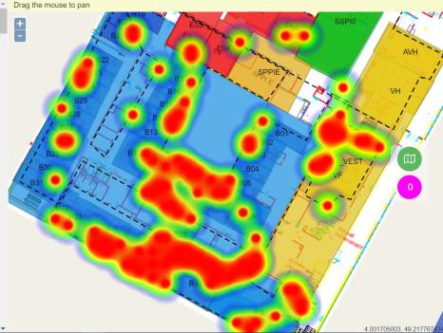
Statistics per asset and by category of assets/people
REAL-TIME AND HISTORICAL DATA
Number of allocated assets vs. unused (which are logged)
Type of tags and which departments are using them
Density of patients compared to density of nurses / doctors in real-time
Density of security personnel compared to density of patients at risk
Machine learning over time can generate usage patterns, analyze, create reports and help optimize workflows
Available R.1.0.2 May 2020
Notes:
Analytics provides metrics on where people are going, what paths they take, where they spend their time, and this can have valuable business benefits, both from a revenue standpoint and from an operations perspective. The hospital can see how long patients are in the emergency waiting area before being seen by a doctor, and what path visitors take to go to the cafeteria or parking areas.
Components ALE provides – ALE provides asset-tracking location analytics, heatmap based on tags and geo-fences. API for a third party business intelligence tool to use the location analytics.
Timeline – May 2020.

Slide 35
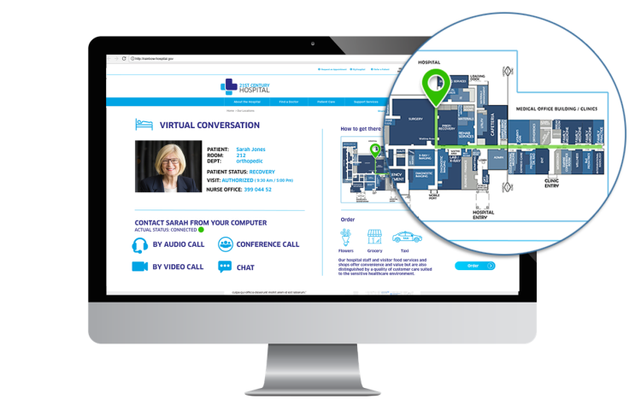
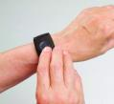
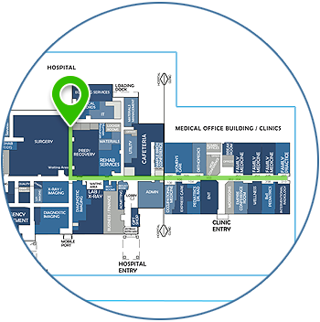
Nurse panic button linked to Asset tracking provides security with incident awareness and location info
1
Nurse encounters emergency situation with hostile patient or violent intruder
3
LBS Cloud notifies security personnel of the alert with the location of the nurse
Nurse presses emergency/panic button on BLE tag, badge or phone which notifies the LBS Cloud
2
OmniVista Cirrus Asset Manager
ISO27001 compliant
2
Nearest security personnel respond and go to the location of the nurse, provided by Stellar LBS
2
4
Available R1.0.3 Q1 2021
Notes:
Nurse panic button linked to Asset tracking provides security with incident awareness and location info. This use case will be supported in Q1 2021.
Timeline – Q1, 2021.

Slide 36
When to sell these solutions?
The needs addressed.
 | OmniAccess Stellar LBS | OmniAccess Stellar Asset Tracking
What features? | Indoor Positioning & Wayfinding (Give a location information to the user. Can be considered as an Indoor GPS.) Geo-Notifications (used for proximity marketing) Real-time and Historical Analytics (smartphone location tracking: where users spend time, dwell time,…) | Locate and track Assets Locate and track People (Patients, Staff) Real-time & Historical Analytics (only on asset or people with a BLE tag: equipment and patient pathway in the building)
What Added Value? | Allows organizations: to enhance the user experience, to engage with customers by communicating in a new way, to optimize operations and workflows, while creating new revenue streams. | Allows hospitals and organizations : to improve equipment utilization and workflows to reduce overhead costs to improve staff satisfaction by reducing the time needed to locate resources: time saving
Who benefits? | Customer’s end users: Large Public Venue - Visitor, In retail – shopper, Healthcare – Patient, Transportation - Traveler, Education - Student… | Employees (e.g. Caregivers)
Targeted vertical | Transportation, Large Public Venue, Hospitality, Healthcare, Education, Government, Retail, Museum… | Focus on Healthcare but works with other verticals
Use cases | What are the busiest routes in the mall? I am looking for the room for my next course in the university. Caregivers solicited to guide visitors lost in the hospital. The museum wants to communicate on some POI like artworks when a visitor is approaching. Oceanopolis wants to know the visitor pathway in the parc. | Where is the nearest bed in my unit? The fugues of patients are daily. How to find them? I am missing a stretcher, it must have been forgotten in another ward. Where my lugages are located in the train? Inventory management in a warehouse. Track a cart.
Notes:
As you know, ALE also provides a LBS solution which provides indoor navigation, wayfinding, geofences and notifications based on proximity to virtual boundaries that can be set up on a floorplan map.
Asset tracking uses different ALE technology and has different use cases. Here is a comparison for you to see the differences.

Slide 37
What’s included with the Asset tracking solution?
All in one offer provided by ALE.
BLE tags, BLE Gateway / Access Points with BLE, Autocalibration Beacons,
Cloud Platform
Mobile Application
One offer provided by ALE
No need for a customized mobile app: the mobile app is provided with the solution
No need for a digitalized map
Services Pro are essential to support the Business Partner: ensure the success of a project
Asset tracking solution can be integrated with a third party software via APIs (e.g: EMR / EHR)
Notes:
What’s included with the Asset tracking solution?
One offer provided by ALE
No need for a customized mobile application: the mobile application is provided with the solution.
No need for a digitalized map.
Services Pro are essential to support the Business Partner: ensure the success of a project.
Asset tracking solution can be integrated with a third party software via APIs (e.g: EMR / EHR).

Slide 38
Asset tracking roi example
Based on 400, 800 and 1200 bed hospitals.
LOST / STOLEN EQUIPMENT
It costs a hospital $4,000 (EUR 3650) per bed in lost / stolen assets per annum according to industry data
Assets not only get lost, they are hard to find. To protect against running short in emergency, the average hospital “over spares” many consumables such as dressings and instruments by approximately 30%
UTILISATION OF EQUIPMENT
Increase utilization rates of medical assets from 45% - 50% to 65 – 70%. This reduces the purchase or lease of additional equipment
LABOUR SAVINGS FROM REDUCED NURSE SEARCH TIMES
Nurses spend on average 72 minutes per shift only searching for equipment according to industry numbers
When you count the number of nurses on a shift, the costs add up quickly and asset tracking will drastically reduce time spent by nurses
ROI Estimate Year 1
Hospital size | 400 Beds | 800 Beds | 1200 Beds
CAPEX on lost/stolen equipment annually | $256,000 / € 232.727 | $512,000 / € 465.455 | $768,000 / € 698.182
Increased utilization of equipment | $320,000 / € 290.909 | $640,000 / € 581.818 | $960,000 / € 872,727
Labor savings from searching time | $1,781,736 / € 1.619.760 | $3,563,472 / € 3.239.520 | $5,345,208 / € 4.859.280
TOTAL COST SAVING PER 1ST YEAR | $2,357,736 / € 2.143.396 | $4,715,472 / € 4.286.793 | $7,073,208 / € 6.430.189
*ROI of Locatible RTLS for Healthcare whitepaper, April 2015
Conversion rate: 1 Euro = 1.10 USD
Notes:
Here’s a ROI example for 400 bed, 800 bed and 1200 bed hospital. As you can see, an asset tracking solution is easily justifiable as the costs of not implementing one are enormous.
LOST / STOLEN EQUIPMENT
It costs a hospital $4,000 (EUR 3650) per bed in lost / stolen assets per annum according to industry data
Assets not only get lost, they are hard to find. To protect against running short in emergency, the average hospital “over spares” many consumables such as dressings and instruments by approximately 30%
UTILISATION OF EQUIPMENT
Increase utilization rates of medical assets from 45% - 50% to 65 – 70%. This reduces the purchase or lease of additional equipment
LABOUR SAVINGS FROM REDUCED NURSE SEARCH TIMES
Nurses spend on average 72 minutes per shift only searching for equipment according to industry numbers
When you count the number of nurses on a shift, the costs add up quickly and asset tracking will drastically reduce time spent by nurses

Slide 39
budget examples for an asset tracking project
Based on WPL List Price | 500 sqm | 2K sqm | 10K sqm
OmniAccess Stellar Asset Tracking | 5 BLE gateways 5 licenses 1Y 40 Asset tags 12 Autocalibration beacons 1 day of PS | 15 BLE gateways 20 licenses 1Y 80 Asset tags 40 Autocalibration beacons 2 days of PS | 60 BLE gateways 100 licenses 1Y 200 Asset tags 130 Autocalibration beacons 3 days of PS
OmniAccess Stellar Asset Tracking Hardware (CAPEX) | 4,886 € | 11,112 € | 35,856 €
OmniAccess Stellar Asset Tracking Licensing per year | 275 € | 1,100 € | 5,500 €
ALE Pro Services (One time) | 1,779 € | 3,558 € | 5,337 €
Total 1st year | 6,940 € | 15,770 € | 46,693 €
OmniAccess Stellar Asset Tracking Hardware (CAPEX) | $5,375 | $12,225 | $39,450
OmniAccess Stellar Asset Tracking Licensing per year | $300 | $1,200 | $6,000
ALE Pro Services (One time) | $1,957 | $3,914 | $5,871
Total 1st year | $7,632 | $17,339 | $51,321
Conversion rate: 1 Euro = 1.10 USD
Licensing is yearly recurring revenue
Notes:
Here are some budgetary examples for an asset tracking project. This was priced from the WPL Euro price list and US prices were developed using a 1 Euro = 1.10 $US ratio.
Aside from the hardware components, you’ll note that there is an annual fee for services related to the OmniAccess Stellar Asset Tracking cloud.

Slide 40
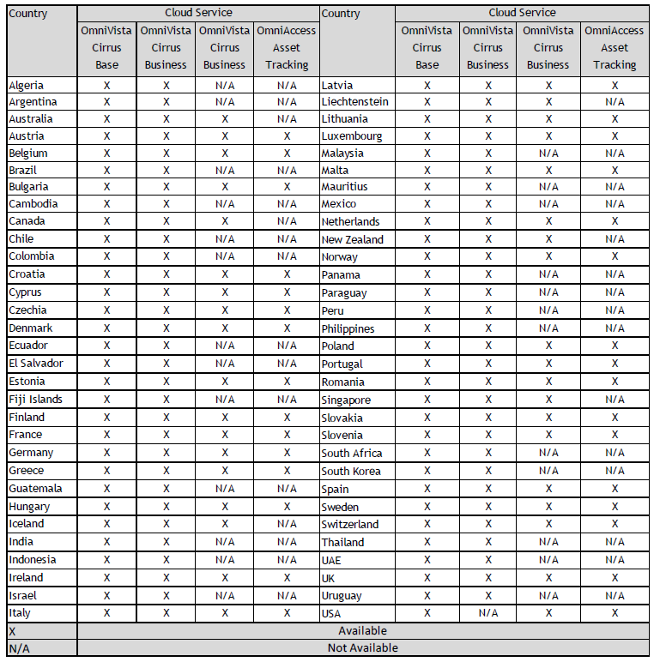
Homologation and certification
Data privacy, asset tags and BLE gateway.
OV Cirrus Asset Manager is hosted in Germany with plans for expansion to other countries (as business dictates)
ALE complies with local regulations and authorizes the use of OmniVista Cirrus and OmniAccess Asset Tracking cloud-based services in the following counties marked with an “X”: asset tracking column on the right (in the green frame)
Country homologation and certification includes:
Data privacy regulation, AND
Asset tag homologation, AND
Gateway homologation
Asset tags are FCC and CE certified
For opportunities in countries that are not listed, contact PLM, Anish Verma (anish.verma@al-enterprise.com)

Slide 41
summary

Slide 42
ALE omniaccess stellar asset tracking summary
ALE Differentiation :
A single Bluetooth infrastructure to cover all your needs: wayfinding, tracking of medical equipment and people, panic button, IoT ...
TCO reduction thanks to this unique infrastructure and cloud solution. Evolution of the solution towards real-time network analytics (Wi-Fi, BLE, switches) and the use of machine learning.
The choice of a sustainable technology, the best indoor IoT protocol: support of the 'mesh' mode (BT4.1), increase of bandwidth (BT5) improvements of the position accuracy (BT5.1 Angle arrival / departure)
The ALE asset tracking solution works with customer’s existing WLAN whereas competitors which provide Wi-Fi based asset tracking solutions can only operate if Wi-Fi density is increased 3 times (on average)
One Supplier for All Services
ALE provides a unique infrastructure that enables you to deploy a LAN or WLAN quality network, as well as value-added services to enhance the customer experience while generating additional revenue:
Location-based services (LBS),
Asset / People tracking,
Wi-Fi networks,
Wired networks,
Cloud
Communication tools (Rainbow, OTNS…)
Notes:
ALE OmniAccess Stellar Asset Tracking Summary
ALE Differentiation :
A single Bluetooth infrastructure to cover all your needs: wayfinding, tracking of medical equipment and people, panic button, IoT ...
TCO reduction thanks to this unique infrastructure and cloud solution. Evolution of the solution towards real-time network analytics (Wifi, switches) and the use of machine learning.
The choice of a sustainable technology, the best indoor IoT protocol: support of the 'mesh' mode (BT4.1), increase of bandwidth (BT5) improvements of the position accuracy (BT5.1 Angle arrival / departure
The ALE asset tracking solution works with customer’s existing WLAN whereas competitors which provide Wi-Fi based asset tracking solutions can only operate if Wi-Fi density is increased 3 times (on average)
One Supplier for All Services
ALE provides a unique infrastructure that enables you to deploy a LAN or WLAN quality network, as well as value-added services to enhance the customer experience while generating additional revenue:
Location-based services (LBS),
Asset / People tracking,
Wi-Fi networks,
Wired networks,
Cloud
Communication tools (Rainbow, OTNS…)

Slide 43
What differentiates us?
Healthcare Focused Solution.
 | OmniAccess Stellar Asset Tracking solution
1. | Architecture based on latest Cloud technology to provide real-time location services along with an unprecedented scale, and high availability
2. | Innovative tags with built-in accelerometer, stops transmission when the assets are not in motion, this ensures higher battery life which in turn provides lower OPEX to maintain tags across the hospital
3. | Lowest cost solution: Innovative solution ensures the lowest cost providing the best ROI for the customers
4. | Complete Turn-key Solution: ALE provides all the components of the Asset tracking solution which simplifies the Asset tracking deployment and keeps the OPEX low
5. | Overlay Solution over existing infrastructure: the Asset tracking solution doesn't impact the existing data network and doesn't require the customer to replace the existing Wi-Fi network – competitors which provide Wi-Fi Based Asset tracking can only work if Wi-Fi density is increased 3 times
6. | Geo-fence based Alerts to cover various healthcare uses case
Notes:
Architecture based on latest cloud technology - Designed from scratch based on the latest cloud technology to provide real-time location services along with an unprecedented scale, and high availability as compared to Stanley/Centrak which are still stuck on windows 2003 and oracle/Mysql databases.
1. Architecture based on latest Cloud technology to provide real-time location services along with an unprecedented scale, and high availability
2. Innovative tags with built-in accelerometer, stops transmission when the assets are not in motion, this ensures higher battery life which in turn provides lower OPEX to maintain tags across the hospital
3. Lowest cost solution: Innovative solution ensures the lowest cost providing the best ROI for the customers
4. Complete Turn-key Solution: ALE provides all the components of the Asset tracking solution which simplifies the Asset tracking deployment and keeps the OPEX low
5. Overlay Solution over existing infrastructure: the Asset tracking solution doesn't impact the existing data network and doesn't require the customer to replace the existing Wi-Fi network – competitors which provide Wi-Fi Based Asset tracking can only work if Wi-Fi density is increased 3 times
6. Geo-fence based Alerts to cover various healthcare uses case

Slide 44
training for omniaccess stellar asset tracking
Definition of a full “On-Line” dedicated training offer for our Business Partners (and Internal)
Dedicated Sales module (ACSR)
Dedicated Presales module with separate ACPS exam
Dedicated post sales module with separate ACFE exam
Post sales training full online in a first step
Course | Title | Type | Duration | Population | Internal | External | Availability
DT00WSA027 | Stellar Asset Tracking (ACSR) | Course w/ Certification incl. | 45 min tbc | Sales | Y | Y | W11
DT00WPS290 | Stellar Asset Tracking Presales | Course | 1 h tbc | Presales | Y | Y | W12
DT00PC2W10 | ACPS Stellar Asset Tracking | Certification | 30 min | Presales | Y | Y | W12
DT00WTE265 | Stellar Asset Tracking Deployment | Course | Tbd | Postsales | Y | Y | DR4
DT00TC1W21 | ACFE Stellar Asset Tracking | Certification | Tbd | Postsales | Y | Y | DR4

Slide 45
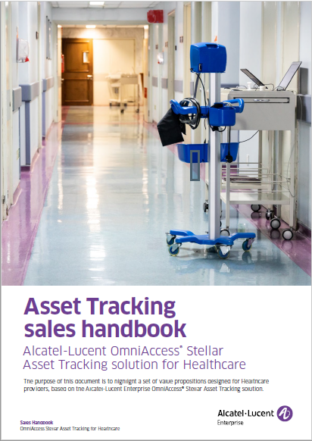
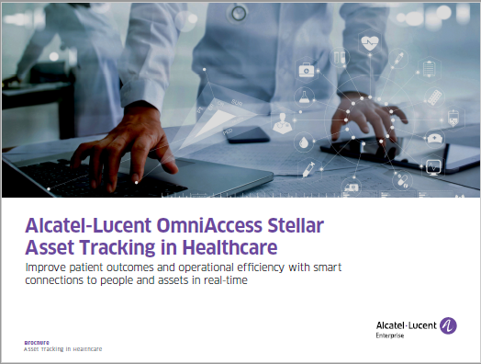
Web, collaterals and sales tools
Public site: https://www.al-enterprise.com/en/products/asset-tracking
ALE blog articles: https://www.al-enterprise.com/en/blog
Business Portal:
Asset tracking page
Healthcare solutions page
Asset Tracking in Healthcare brochure
Asset Tracking in Healthcare sales handbook
Product datasheets:
OmniAccess Stellar BLE Gateway AP1201BG
OmniAccess Stellar WLAN AP1201
OmniAccess Stellar WLAN AP1230
Autocalibration beacons
Mobile BLE tags (square or card shape)
Notes:
There is a number of sales and marketing resources available to you on the Business Portal, such as collaterals, documents and slides. These are links to some of the key resources, for your reference.

Slide 46
Customer references
Notes:
This is just a small sample of our Healthcare customers worldwide. You can find information on all of them on our web site, if you’re interested.
You can get more customer references and information on our web site:
http://enterprise.alcatel-lucent.com/?content=CustomerReferences&page=overview
and on our dedicated healthcare page on the ALE Business Portal:
https://businessportal2.alcatel-lucent.com/solutions/industry/healthcare

Slide 47
CONTACTUS
WEBSITE
www.al-enterprise.com
Follow us on:
The Alcatel-Lucent name and logo are trademarks of Nokia used under license by ALE.

Slide 48
THANK YOU

